Slide 1
K-Map and arithmetic circuit
1

Slide 2
Karnaugh map-- Minimization method
A Karnaugh map is a visual display of the fundamental products needed for a sum-of-products solution.
Karnaugh maps provide visual notation of simplifications.
A Karnaugh map consists of a grid of squares, each square representing one canonical minterm combination of the variables or their inverse

Slide 3
K-map
Arranged with squares representing minterms which differ by only one variable to be adjacent both vertically and horizontally
Squares on one edge of the map are regarded as adjacent to those on the opposite edge

Slide 4
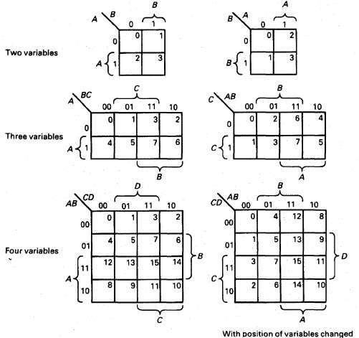

Slide 5
Minimization technique using Karnaugh map
The expression to be minimized should
generally be in sum-of-product form.
The function is 'mapped' onto the Karnaugh
map by marking a 1 in those squares
corresponding to the terms in the expression
to be simplified.

Slide 6
Minimization technique
Pairs of 1's on the map which are adjacent
are combined using the theorem:
P(A+A')=P Where P is any Boolean expression
If two or more pairs are also adjacent, these can also be combined using the same theorem.

Slide 7
Minimization technique
The minimization procedure consists of
recognizing multiple pairs
A group of two 1's eliminates one variable
from the original minterm while a group of
four 1' s eliminates two variables and a group of eight 1' s eliminates three variables

Slide 8
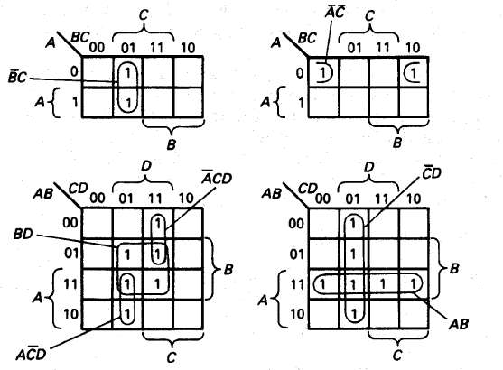
Examples of grouping on K-map

Slide 9
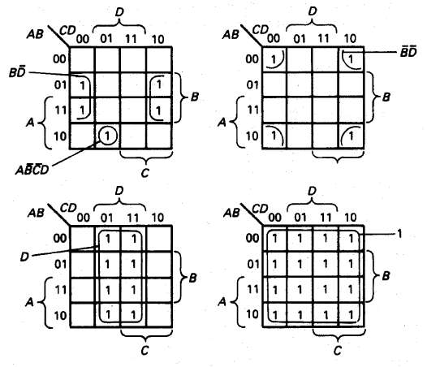
Examples of grouping on K-map

Slide 10
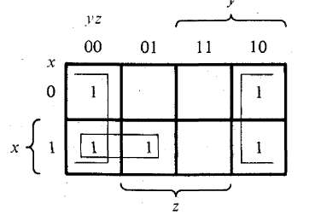
Example
1.Simply the Boolean function:
F(x, y, z) =Σ(0,2,4,5,6)

Slide 11
Example
First, we combine the four adjacent squares in the first and last columns ,to give the single literal term z´
The remaining single square representing minterm 5 is combined with an adjacent square that has already been used once. This is not only permissible, but rather desirable. The simplified function is
F = z’ + xy'

Slide 12
NOTE
It is not necessary to convert the original function into canonical form before minimization
– Each term in the function can be mapped onto the Karnaugh map directly, noting that a term with one variable missing maps onto two adjacent squares, a term with two variables missing maps onto four squares, etc.

Slide 13
Example
2. Simplify the Boolean function
F(A,B,C,D)=A´B´C´+B´CD´+A´BCD´+AB´C´
The area in the map covered by this function consists of the squares marked with 1’s in the figure
Each term of three literals is represented in the map by two squares

Slide 14
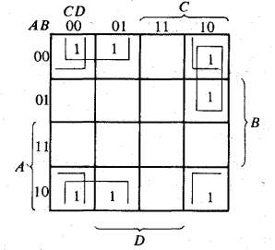
Example
The simplified function is:
F=B´D´+A´CD´+B´C´

Slide 15
Simplify
(1)F(w,x,y,z) = ∑(0,1,2,4,5,6,8,9,12,13,14)
Solution… F=y’+w’z’+xz’
(2)F = AB’C’D’+A’BC’D+A’B’C’D+A’B’CD
+A’BCD+AB’C’D
Solution… F=AB’C’+A’D

Slide 16
Simplify
Simplify the following Boolean function in SOP and POS.
F(A,B,C,D)=Ʃ(0,1,2,5,8,9,10)
SOP=B’D’+B’C’+A’C’D
POS=(A’+B’)(C’+D’)(B’+D)

Slide 17
Don't-care condition- K Map
There are applications where certain combination of variables cannot occur or it does not matter what the outputs are if the combination does occur,
For Eg: conversion from BCD to Excess 3.
This combination is known as a don't-care condition.
Don't-care conditions are marked on the Karnaugh map as X’s or d’s.

Slide 18
Don't-care condition
Each X can be considered as either a 0 or 1, whichever is best for minimization
A function with one or more don't-care conditions is called an incompletely specified function

Slide 19
Simplify
(1) F( w, x, y, z )=Σ(1,3,7,11,15) +d(0,2,5)
Solution…F= w’z + yz
(2) F(A,B,C,D)= Σm(4,5,6,8,9,10,13)+ d(0,7,15)

Slide 20
Arithmetic Circuits

Slide 21
Adders
Adders is an arithmetic circuit which performs binary addition operation.
Combinational circuit consists of input variable, logic gates and output variable.
Logic gates accepts signals from inputs and generate signals to the outputs.
There are 3 types of adders:
1. Half Adder
2. Full Adder
3. Parallel Binary Adder.

Slide 22
Half Adder
Half adder is a circuit that has two inputs A and B, and two outputs, Sum and Carry.
It adds A and B according to the rules for binary addition and outputs the sum and carry.
The Block diagram and Truth Table for a Half adder are shown in Figure .
The truth table follows the rules for binary addition. The last line shows 1 + 1 is 10.

Slide 23
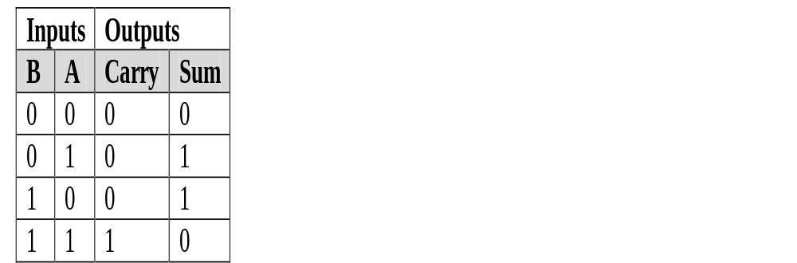
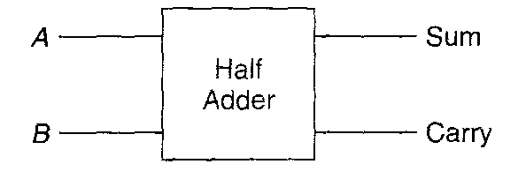
Half Adder

Slide 24
Half Adder
Sum= AB’+A’B
Carry=AB
The sum is identical to the XOR, and the carry is identical to AND gate.
One way to construct a half adder is shown fig1.
Another way to construct a half adder is shown in Fig 2.

Slide 25
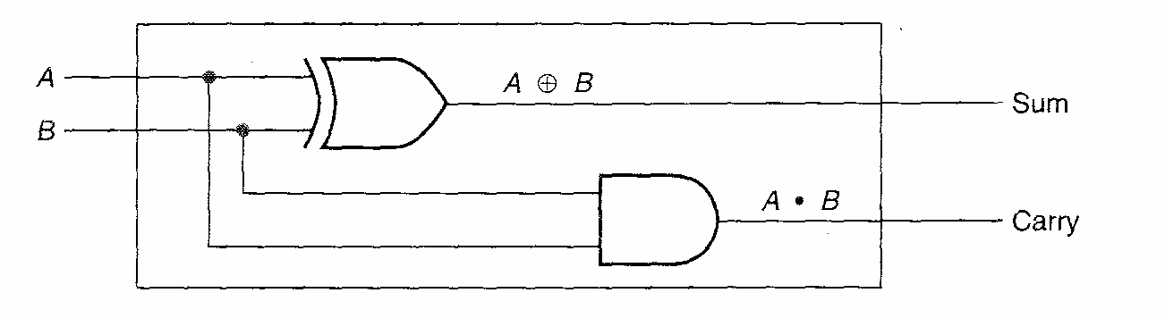
Half Adder --Figure 1

Slide 26
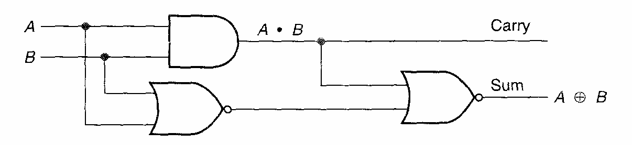
Figure 2 Half adder using AND gate and two NOR gates

Slide 27
Full Adder
Half adder added two inputs, A and B,
The full adder adds three inputs together. A, B, and a carry from a previous addition, and outputs a sum and carry.
The truth table follows the rules for binary addition. The block diagram and truth table for a full adder are shown in Figure 12(a).

Slide 28
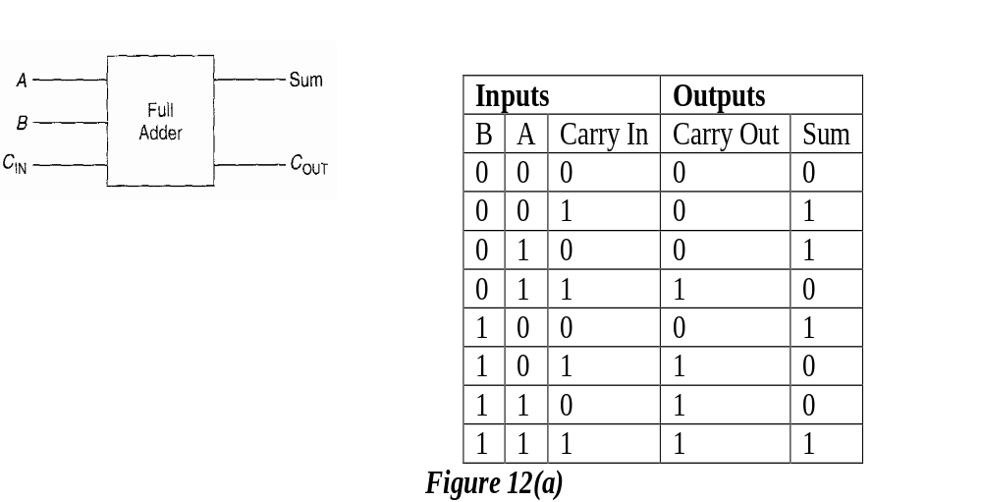
Block Diagram & Truth Table

Slide 29
TRUTH TABLE
A | B | C | Sum | Carry
0 | 0 | 0 | 0 | 0
0 | 0 | 1 | 1 | 0
0 | 1 | 0 | 1 | 0
0 | 1 | 1 | 0 | 1
1 | 0 | 0 | 1 | 0
1 | 0 | 1 | 0 | 1
1 | 1 | 0 | 0 | 1
1 | 1 | 1 | 1 | 1

Slide 30
Expression-From Truth Table
Sum=A’B’C+A’BC’+AB’C’+ABC
=A’(B’C+BC’)+A(B’C’+BC)
=A’(B C) +A (B C)
Sum =A B C
Carry=A’BC+AB’C+ABC’+ABC
=BC(A’+A)+AB’C+ABC’
=BC+AB’C+ABC’
Carry=AB+AC+BC ( By K-map)

Slide 31
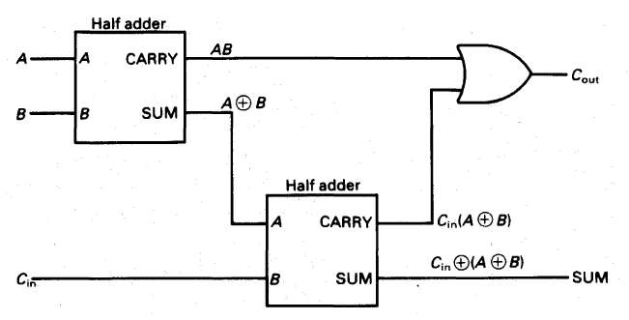
Implementation of a Full Adder using 2 Half Adders

Slide 32
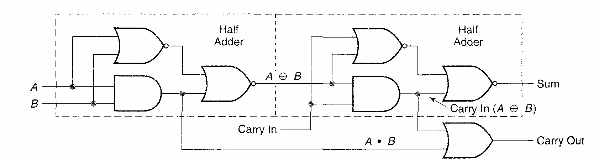
Full Adder using AND gate and NOR gate and OR gate.

Slide 33
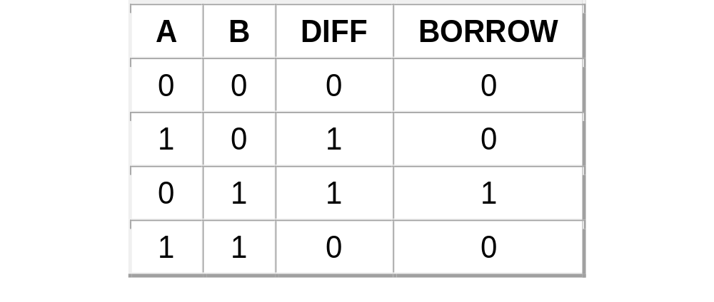
Half Subtractor
The circuit has two outputs labelled DIFF [ Di ] and BORROW [ B_{O} ]. A Truth Table for the circuit & Expressions are:
B_{O}=A’ B , D_{i} = A B’ + A’ B

Slide 34
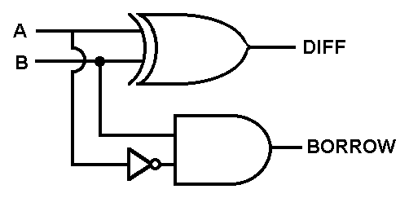
Half Subtractor
Consider the circuit below:

Slide 35
FULL SUBTRACTOR
A full subtractor is made by combining two half- subtractors and an additional OR-gate.
A full subtractor has the borrow in capability (denoted as BOR_{IN} in the diagram below) and so allows cascading which results in the possibility of multi-bit subtraction. The circuit diagram for a full subtractor is given below.

Slide 36
Truth Table for a Full Subtractor , D=A-B-B_{IN}
A
B
BOR
D
BOR
IN
O
UT
0
0
0
0
0
0
0
1
1
1
0
1
0
1
1
0
1
1
0
1
1
0
0
1
0
1
0
1
0
0
1
1
0
0
0
1
1
1
1
1

Slide 37
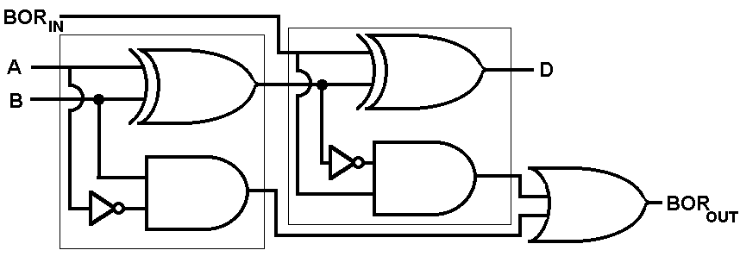
FULL SUBTRACTOR

Slide 38
Decoder
A decoder is a combinational circuit that converts binary information from n input lines to a maximum of 2^{n} unique output lines.
If n-bit decoded information has unused or don’t care combinations, the decoder output will have fewer than 2^{n} outputs.
The decoder called n-to-m line decoder
where m<= 2^{n} .
Eg: 2-to-4 line decoder, 3-to-8 line decoder.

Slide 39
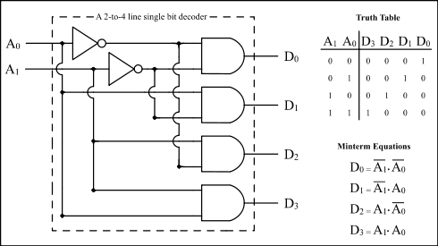
2-to-4 Line decoder

Slide 40
3-to-8 line decoder
This decoder can be referred to in several ways. It can be called a 3-line-to-8-line decoder, because it has three input lines and eight output lines.
It could also be called a binary-octal decoder or converters because it takes a three bit binary input code and activates the one of the eight outputs corresponding to that code.
It is also referred to as a 1-of-8 decoder, because only 1 of the 8 outputs is activated at a time.

Slide 41
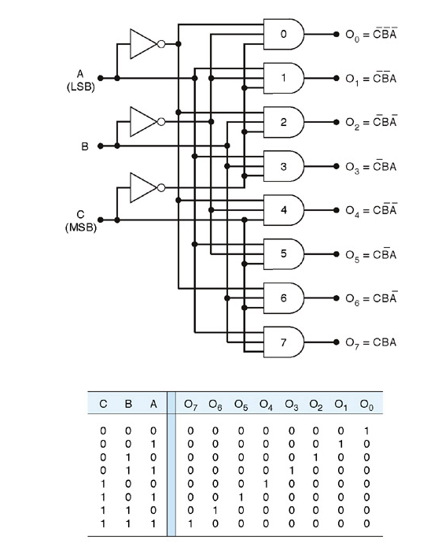
3-to-8 line decoder

Slide 42
ENCODER
The encoder is a combinational circuit that performs the reverse operation of the decoder.
The encoder has a maximum of 2^{n} inputs and n outputs. The block diagram and the truth table of a 4-to-2 encoder are shown in figure.

Slide 43
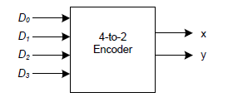
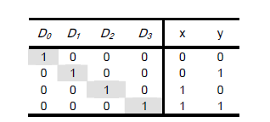
4-to-2 Encoder

Slide 44
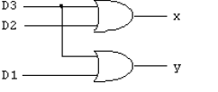
From the truth table, we can expressed the outputs as :
x= D₂ +D₃
y= D₁ +D₃
Therefore, the logic diagram for the 4-to-2 Encoder .

Slide 45
Example for Encoder is octal-to-binary(8-to-3) Encoder
D0 | D1 | D2 | D3 | D4 | D5 | D6 | D7 | X | Y | Z
1 | 0 | 0 | 0 | 0 | 0 | 0 | 0 | 0 | 0 | 0
0 | 1 | 0 | 0 | 0 | 0 | 0 | 0 | 0 | 0 | 1
0 | 0 | 1 | 0 | 0 | 0 | 0 | 0 | 0 | 1 | 0
0 | 0 | 0 | 1 | 0 | 0 | 0 | 0 | 0 | 1 | 1
0 | 0 | 0 | 0 | 1 | 0 | 0 | 0 | 1 | 0 | 0
0 | 0 | 0 | 0 | 0 | 1 | 0 | 0 | 1 | 0 | 1
0 | 0 | 0 | 0 | 0 | 0 | 1 | 0 | 1 | 1 | 0
0 | 0 | 0 | 0 | 0 | 0 | 0 | 1 | 1 | 1 | 1

Slide 46
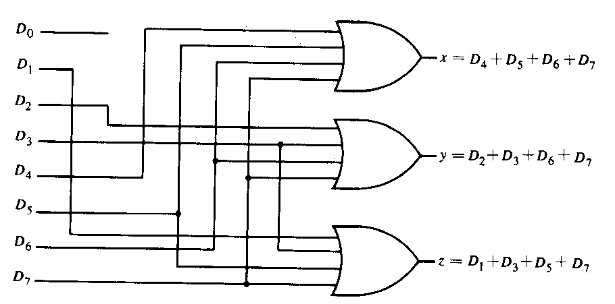
Example for Encoder is octal to binary encoder

Slide 47
Multiplexers
A multiplexer in short MUX is a device, which allows sharing of common line from more than one input line.
A MUX connects one of the n inputs to a single output line so that the logical value of input is transferred to the output.
Thus , a multiplexer has n inputs and one output.

Slide 48
Multiplexer
A digital multiplexer is a combinational circuit that selects binary information from one of many input lines and directs it to a single output line. The selection of a particular input line is controlled by a set of selection lines.
Normally, there are 2^{n} input lines and n selection lines whose bit combination determine which input is selected.
Multiplexing means transmitting over a smaller number of lines.

Slide 49
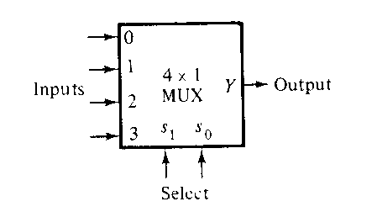
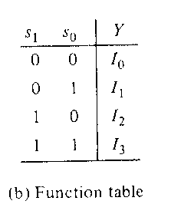
Example:4-to-1 line multiplexer

Slide 50
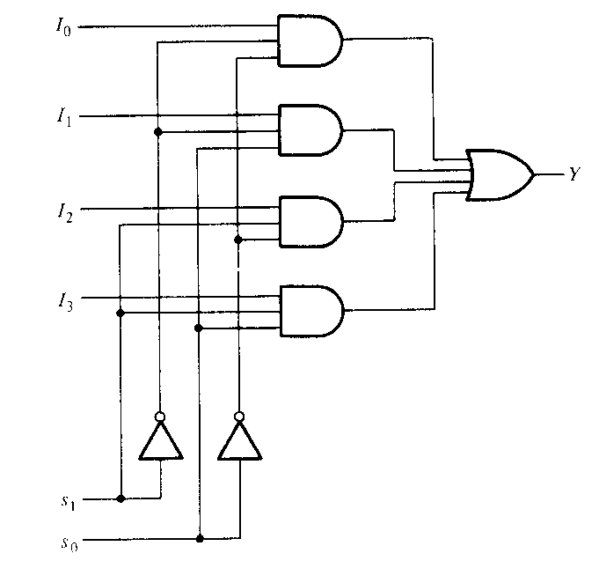
A 4-to-1 line multiplexer

Slide 51
Demultiplexer
A demultiplexer is a circuit that receives information on a single line and transmit this information on one of 2^{n} possible output lines.
The selection of a specific output line is controlled by the bit values of n selection lines.
A decoder with an enable input can function as a demultiplexer.

Slide 52
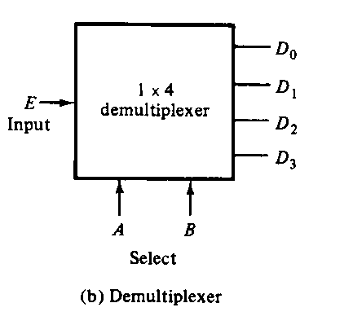
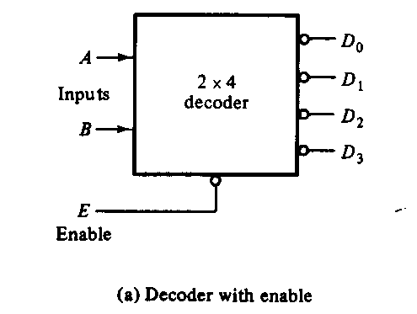
Block Diagram

